Slide 1


VISVESVARAYA TECHNOLOGICAL UNIVERSITY “JnanaSangama”, Belagavi-590018, Karnataka, India
IMPACT COLLEGE OF ENGINEERING AND APPLIED SCIENCES
Sahakarnagar, Bengaluru – 560092
Department of Computer Science and Engineering
INTERNSHIP PRESENTATION
“STOCK MANAGEMENT SYSTEM”
INTERNAL GUIDE:
MRS. SHWETHA TJ
ASST. PROFESSOR
DEPT. OF CS&E
EXTERNAL GUIDE:
HARISH. N
Karunadu Technologies Pvt. Ltd.
PRESENTED BY:
SHUBHAM KUMAR (1IC20CS028)
DEPT. OF CS&E

Slide 2
ABSTRACT
Our innovative Stock Management System redefines inventory control, harnessing state-of-the-art technologies like barcode scanning and instantaneous data processing. Featuring robust functionalities such as inventory tracking, order orchestration, and comprehensive analytics, it empowers enterprises with unprecedented command over their stock. Through its user-friendly interface and scalable infrastructure, the system ensures meticulous inventory accuracy, effectively mitigating stock shortages and averting surplus inventory. Enterprises stand to reap the rewards of optimized order fulfillment and proactive inventory management, yielding enhanced operational efficiency and significant cost reductions. This system emerges as a cornerstone solution for enterprises spanning diverse industries, furnishing invaluable insights and fostering enduring competitive advantages. Future iterations may seamlessly integrate advanced analytics for predictive inventory optimization, amplifying its transformative potential for enterprises committed to operational excellence. Embrace the evolution of inventory oversight with our Stock Management System and reimagine the management of your inventory assets.

Slide 3
CONTENTS
Abstract
Introduction
What is Stock Management?
Why we use Stock Management?
Problem Statement
System Requirements and Specification
Stock Management Flow Chart.
Importance of Stock Management.
Disadvantages of Stock Management?
Results
Conclusion
References

Slide 4
INTRODUCTION
SQL Server Management Studio Functionality: SSMS simplifies tasks like creating, modifying, and deleting databases and objects, with a robust SQL query editor.
Visual Database Design: It offers visual database design features for schema management.
Data Import/Export: Streamlines data import/export operations for efficient data movement.
Performance Optimization: Tools for performance optimization enhance database efficiency.
Security Management: Capabilities for security management ensure data protection.
Integration with Azure and Microsoft Products: Seamlessly integrates with Azure and other Microsoft products for comprehensive management.
Extensibility and Version Control: Supports extensibility with custom add-ins and integration with version control systems like Git for efficient tracking of changes.
01

Slide 5
What is Stock Management?
Stock management, or inventory control, is the business fancy way of saying "having the right amount of stuff." It's like planning how many cookies to bake for a bake sale. You don't want to run out, but leftover cookies get stale. This process involves looking ahead (predicting demand), keeping track (monitoring stock levels), and taking action (reordering or adjusting stock) to hit that sweet spot of having just what you need, when you need it.
02

Slide 6
Why we use Stock Management?
1.Preventing Shortages: Stock management ensures that a business always has enough products or materials
available to meet customer demand, preventing situations where customers can't buy what they want.
2.Cost Savings: It helps control expenses by minimizing storage and holding costs associated with keeping
excess inventory. This frees up money for other business needs.
3.Happy Customers: Maintaining adequate stock levels keeps customers satisfied because they can find what they need when they need it, leading to repeat business.
5.Profit Maximization: It helps businesses make informed decisions about purchasing and pricing, ultimately maximizing profit margins.
03

Slide 7
PROBLEM STATEMENT
The problem with current stock management lies in manual processes, leading to inefficiencies, inaccuracies, and increased operational costs. Implementing an automated system is crucial for accurate, efficient, and cost-effective inventory management. This requires centralized data access, real-time monitoring, and streamlined processes to optimize resource utilization and enhance business performance.
04

Slide 8
SYSTEM
REQUIREMENTS AND SPECIFICATION
HARDWARE REQUIREMENTS:
SOFTWARE REQUIREMENTS:
Operating System: Windows
Processor: intel i3 minimum
Ram: 8 GB minimum
Hard Disk: 256 GB minimum
Programming language: C#
IDE: Visual Studio 2015
Database: SQL Server Management Studio
Google Chrome, Firefox, Microsoft Edge or Brave Browser with Extension Support.
05

Slide 9


Stock Management Flow Chart....
Raw Materials-->Inspection-->Processing-->Setup-->Final Product
06

Slide 10
Importance of Stock Management....
The importance of stock management lies in balancing product availability with cost efficiency, ensuring businesses meet customer demand while optimizing resources.
Cost Control
Customer Satisfaction
Cash Flow Optimization
Effective stock management helps minimize holding costs, such as storage, insurance, and depreciation, allowing businesses to allocate resources more efficiently.
Maintaining optimal stock levels ensures that products are readily available, preventing stockouts and backorders, and leading to satisfied customers.
Efficient stock management can free up capital that would otherwise be tied up in excess inventory, which can be reinvested or used for other operational needs.
07

Slide 11
Disadvantages of Stock Management...
Excess Holding Costs
Maintaining excessive inventory levels can lead to high storage, insurance, and depreciation costs, impacting profitability.
Product Obsolescence
Inefficient stock management can lead to overstocking, resulting in increased holding costs and the risk of products becoming obsolete, while understocking can result in stockouts, dissatisfied customers, and lost sales.
Failure to rotate or sell older inventory can result in product obsolescence and financial losses.
Customer Dissatisfaction
Stockouts and delays in fulfilling orders due to inadequate stock management can lead to dissatisfied customers and damage a business's reputation.
08

Slide 12

Results.....
"Visualizing Stock Management: Results for Clarity and Illustration."
Efficient stock management is the cornerstone of successful businesses, ensuring the right balance between product availability and cost control.
09

Slide 13
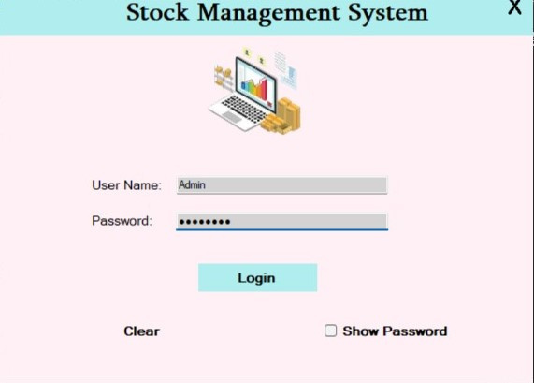
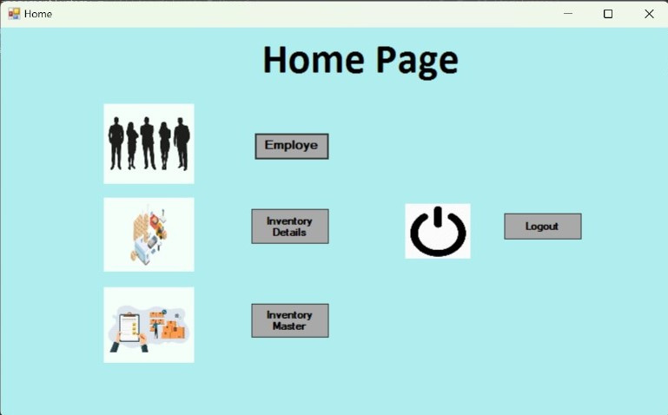
Login Page
Home Page
10

Slide 14
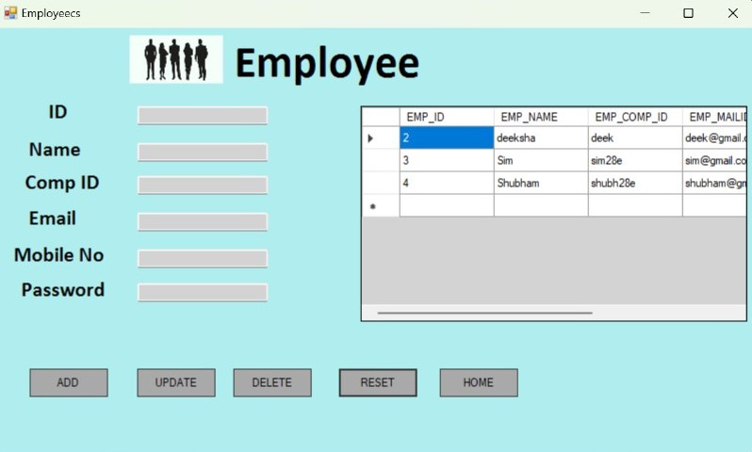
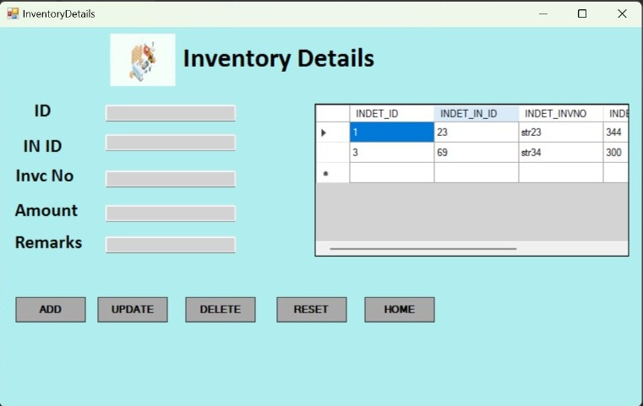
Employee Details
Inventory Details
11

Slide 15
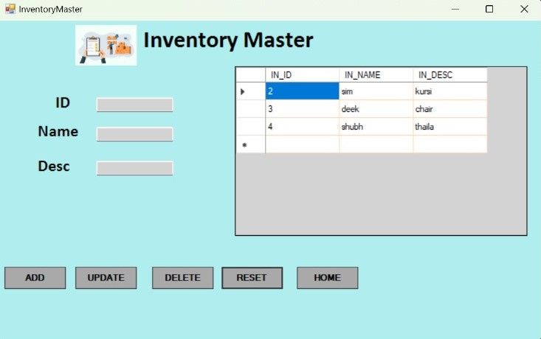
Inventory Master
12

Slide 16
CONCLUSION
In conclusion, stock management is a fundamental element of effective business operations. It enables organizations to strike the delicate balance between meeting customer demand, controlling costs, and optimizing resources. With careful planning, data-driven decision-making, and the adoption of best practices, businesses can achieve better financial results, customer satisfaction, and long-term success in today's competitive markets. Effective stock management is not merely a logistical necessity but a strategic advantage that can drive profitability and business growth.
13

Slide 17
REFERENCES
SQL Server Management studio url: https://learn.microsoft.com/enus/sql/ssms/download-sql-server-management-studio-ssms?view=sql-server-ver16.
Visual Studio 2015: https://visualstudio.microsoft.com/vs/older-downloads/
E-Commerce Store Inventory in Microsoft SQL Database.
Web Application ASP.NET: https://dotnet.microsoft.com/en-us/apps/aspnet

Slide 18

Thank You!!
Effective stock management is a key driver of business success, ensuring profitability and customer satisfaction.

